Slide 1
Wine Quality Prediction
Susumu Iwasaki

Slide 2
I. Overview of this project
Purpose
To predict wine quality (response) by using 11 features such as “acidity”, “sugar”, “pH”, “sulfur dioxide”, etc.
(2) Data Source
UCL ML data repository (https://archive.ics.uci.edu/ml/datasets.php)
Wine Quality data set
(https://archive.ics.uci.edu/ml/datasets/wine+quality)

Slide 3
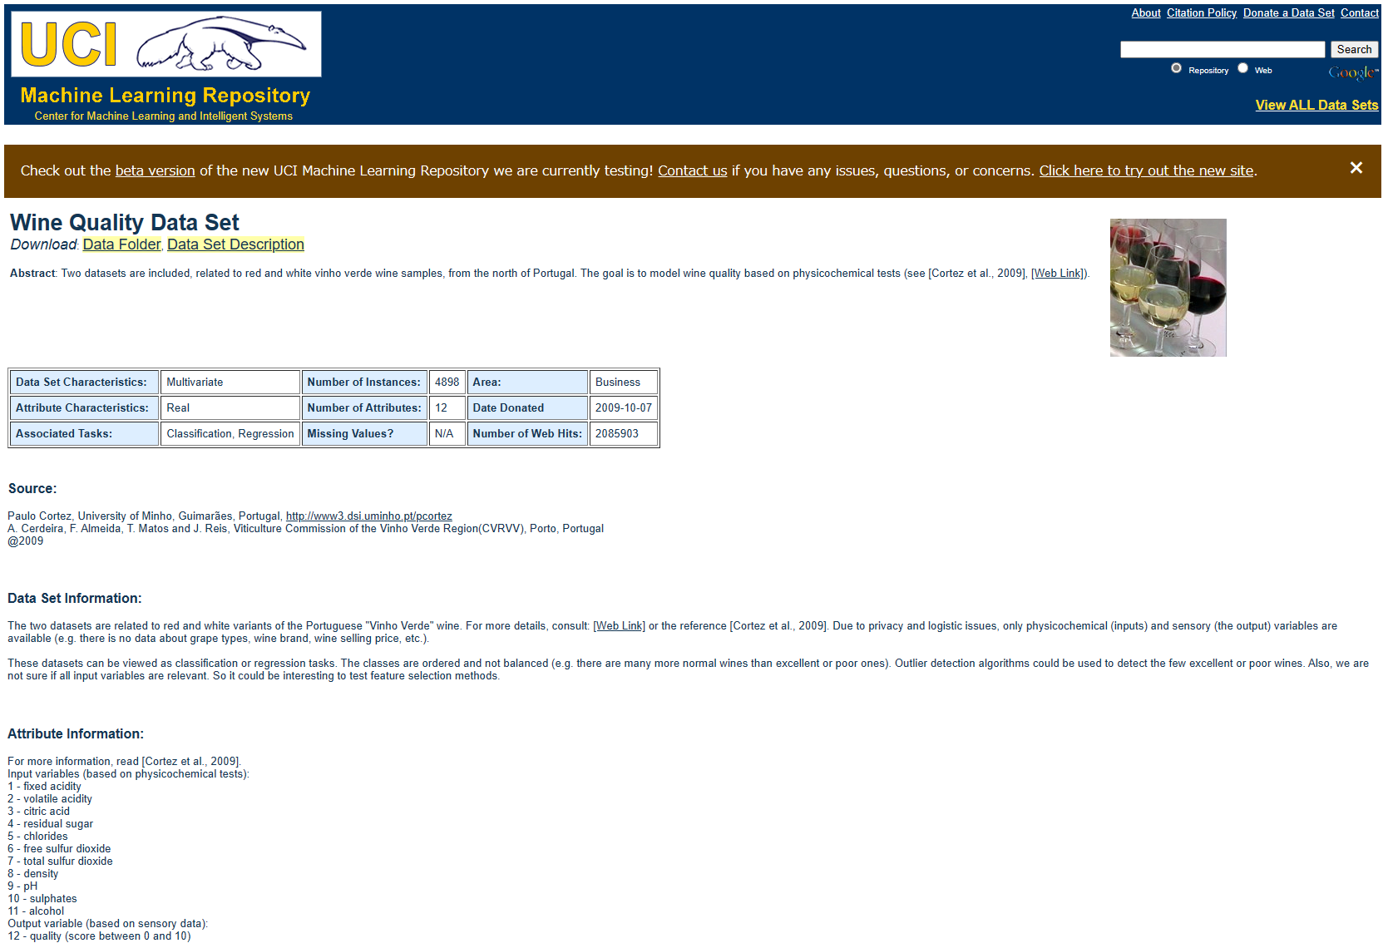

Slide 4
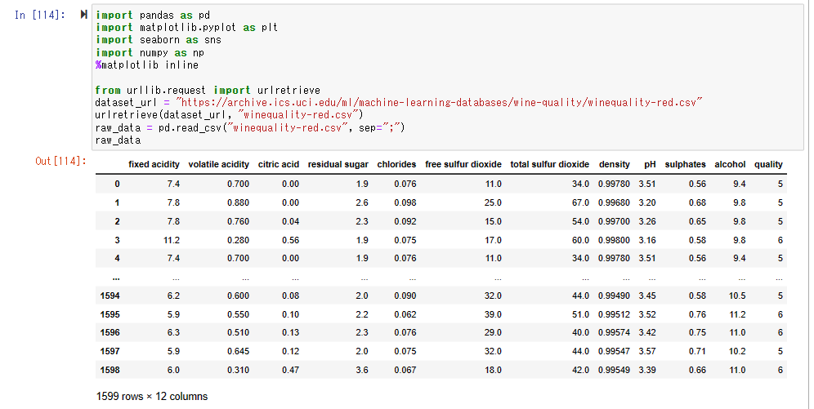
< Raw data view >

Slide 5
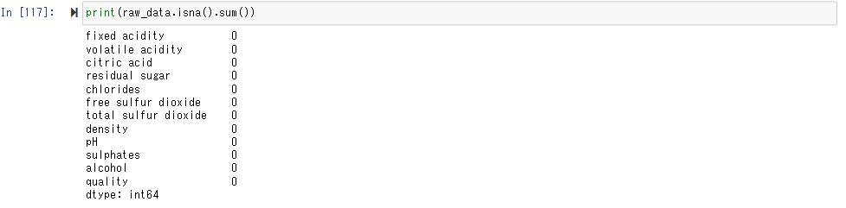
II. Exploratory Data Analysis
1. Check whether null data exist
-> No null data !

Slide 6
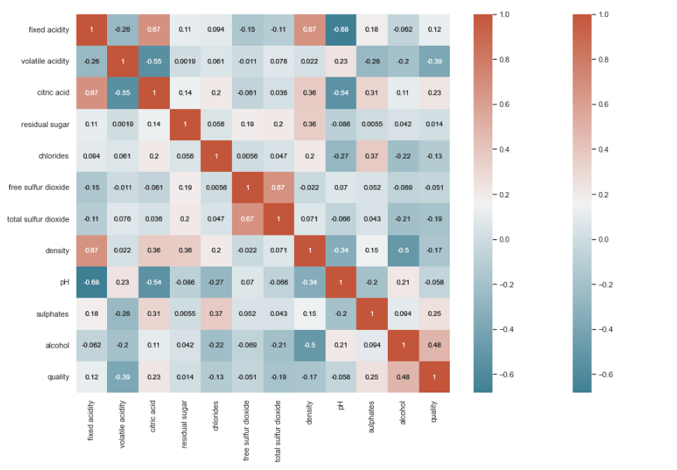
2. Correlation between features (1)
No correlation coefficient over 0.7
->
No collinearity b/n features

Slide 7
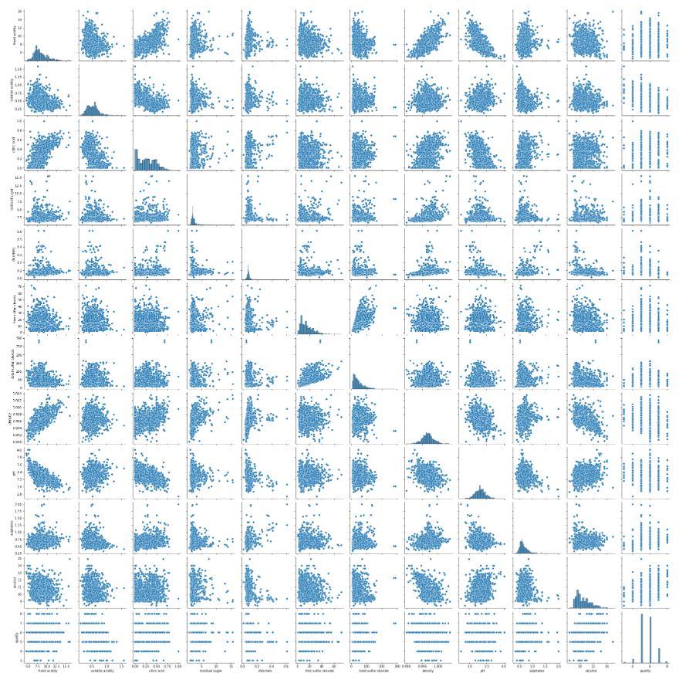
2. Correlation with features (2)

Slide 8
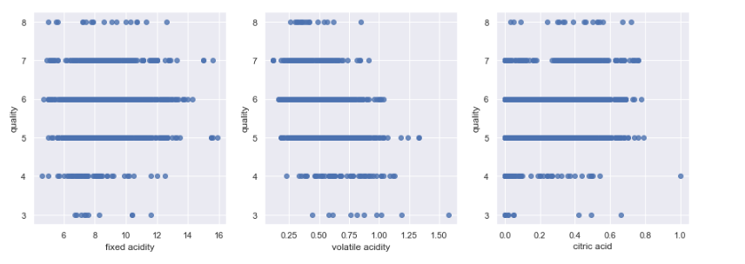
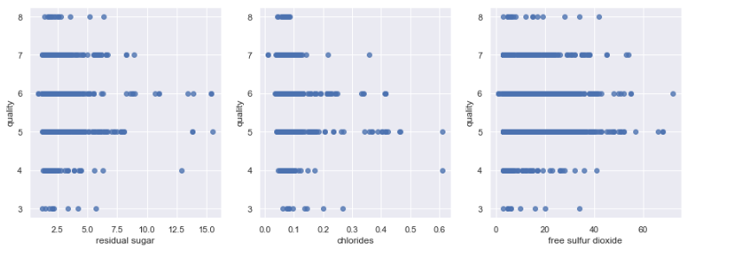
3. Check the outliners (1)

Slide 9
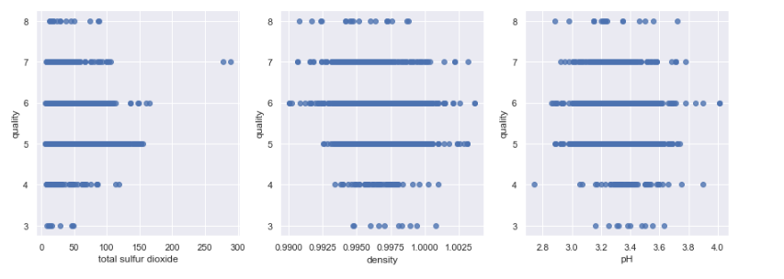
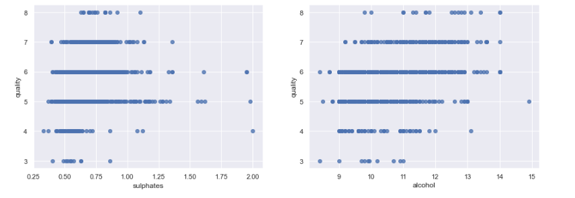
3. Check the outliners (2)

Slide 10
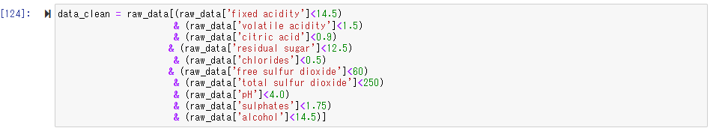
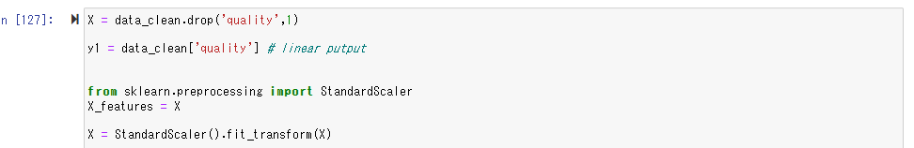
3. Check the outliners – remove the outliners -
4. Data normalization

Slide 11
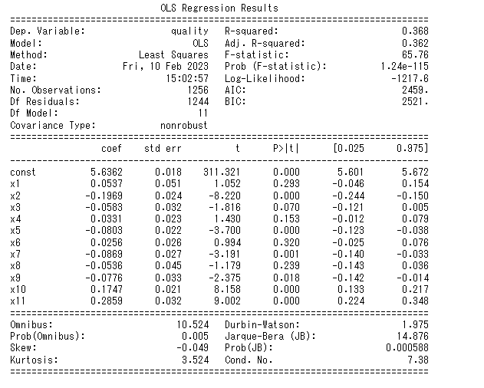
III. Modelling 1. Regression Model – Linear Regression -
x1: 'fixed acidity’
x2: 'volatile acidity’
x3: 'citric acid’
x4: 'residual sugar’
x5: 'chlorides’
x6: 'free sulfur dioxide’ x7: 'total sulfur dioxide’ x8: 'density’
x9: 'pH’
x10: 'sulphates’
x11: 'alcohol’

Slide 12
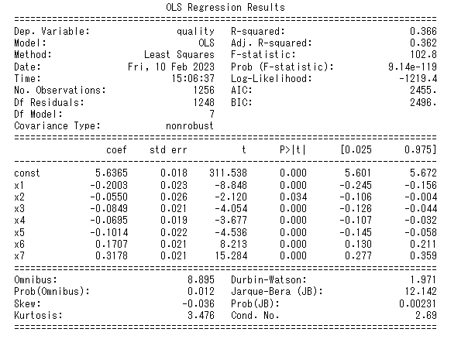
Backward selection
- The feature, the p-value of which is over 0.1, and maximum among them is deleted one by one, and calculated. This process is recursively done four times. (Consequently, “free sulfur dioxide”, “fixed acidity”, “density” and “residual sugar” are removed).
- 'volatile acidity’, 'citric acid', 'chlorides', 'total sulfur dioxide', 'pH', 'sulphates' and 'alcohol’ are the remaining features.
- The final results of backward selection are as follows:
< Preliminary Thought>
Compared to the model without backward selection, R-squared of the final model is getting worse a little(0.368 -> 0.366).
MSE (Mean Squared Error) is getting better a little. (0.398 -> 0.400)
As the value of R squared and MSE is not relatively good, this multiple regression model is not estimated as a good fit model for this data set.

Slide 13
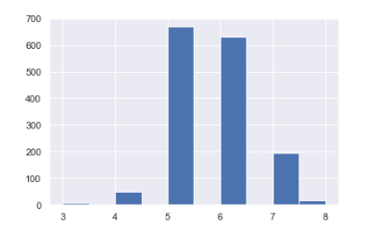
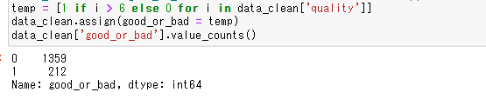
2. Classification Model
- Histogram of responses
Most of responses are 5 or 6 !
This may be the reason why the multiple regression model does not work.
- Conversion to binary classification

Slide 14
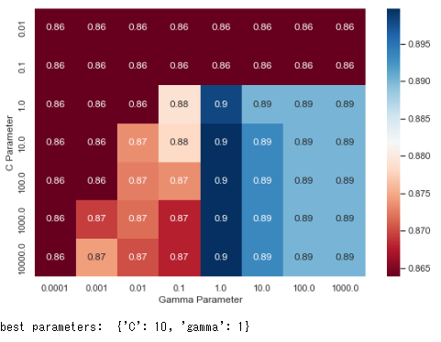
(1) Support Vector Classification
- Grid Search for best C and gamma
- Further Grid Search for fine tuning C and kernel (“linear”, “polynomial”, and “rbf”)
C = 4, gamma = 1, kernel = “rbf” are the best parameters
Accuracy: 0.911

Slide 15
(2) KNeighbors Classifier
Accuracy: 0.921
(3) Decision Tree Classifier
Accuracy: 0.886
(4) Random Forest Classifier
Through “RandomizedSearchCV”, best parameters such as “max depth” and “n estimators” are 12 and 400 respectively.
Accuracy: 0.924

Slide 16
(5) Ada Boosting Classifier
Accuracy: 0.927
(6) Gradient Boosting Classifier
Accuracy: 0.924
(7) XG Boosting Classifier
Accuracy: 0.917

Slide 17
1st round results
Ada Boost Classifier (accuracy: 0.927)
> Gradient Boosting Classifier (0.924)
= Random Forest Classifier (0.924)
> KNeighbors Classifier (0.921)
> XG Boost Classifier (0.917)
> SVC (c=4, gamma=1, kernel="rbf: 0.911)
> Linear SVC (0.908)
> Decision Tree (0.886)
“Ada Boosting Classifier” is the best fit?

Slide 18
IV. Discussion and Analysis
Classification model is better than multiple linear regression model.
As for the classification model, preliminary calculation suggests that Ada Boosting Classifier is the best-fit model for wine quality data set.
This result would be caused by specific test-train set split, so cross validation should be carried out.
K-Fold cross validation

Slide 19
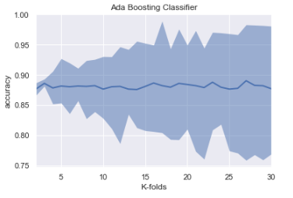
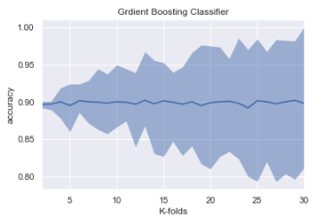
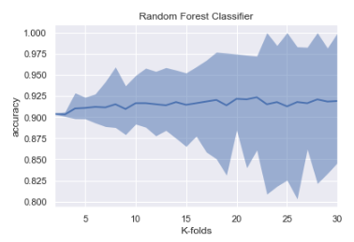
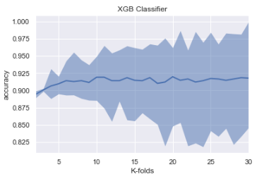
1. K-fold Cross Validation
Accuracy – K-folds plots for each classifier
(Solid line is the average accuracy, the grayed area is the range between the max and min.)
Through K-folds cross validation, Ada Boosting Classifier is worse than the other 3 models.
Random Forest Classifier or XG Boosting Classifier would be the best

Slide 20
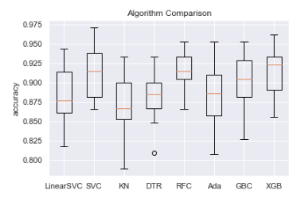
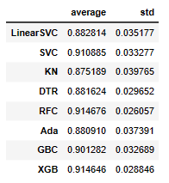
K-fold Cross Validation (2)
Boxplots of accuracy under each classifier (K=15)
This boxplots shows Random Forest Classifier (average accuracy: 0.915, std: 0.03) or XG Boosting Classifier (0.915, 0.03)can be the best, especially in consideration of its deviation.

Slide 21
V. Conclusion
Multiple Linear Regression Model does not work well, because the responses “quality” are concentrated into certain range.
After converted into binary classification, wine quality can be predicted in accuracy over 90%.
At the initial data split between training and test, Ada Boosting Classifier may be the best, and Random Forest Classifier and Gradient Boosting Classifier are the second.
After K-Folds cross validation, Random Forest Classifier and XG Boosting Classifier can be estimated as the best models.

